Slide 1



Music Store Data Analysis

Slide 2

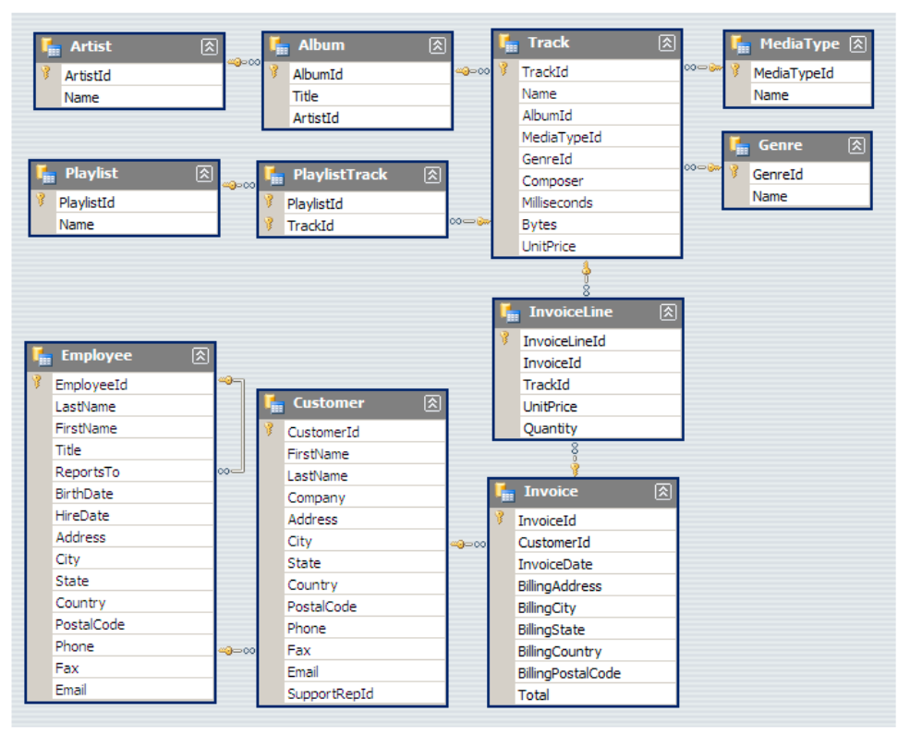
Music Database Schema

Slide 3

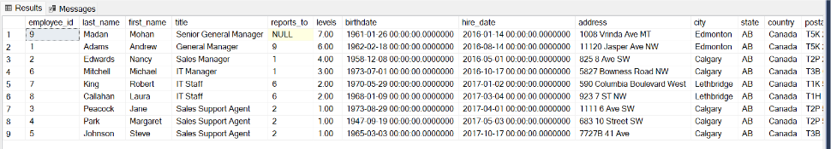
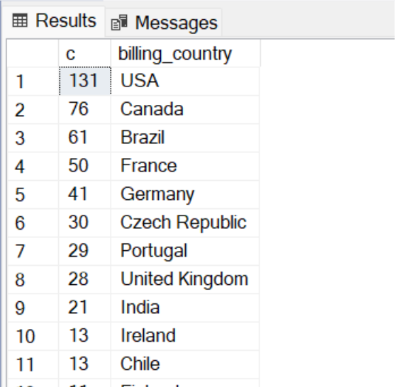
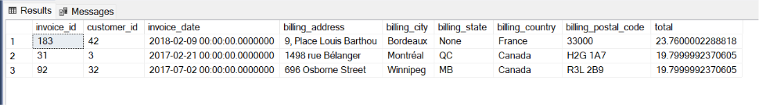
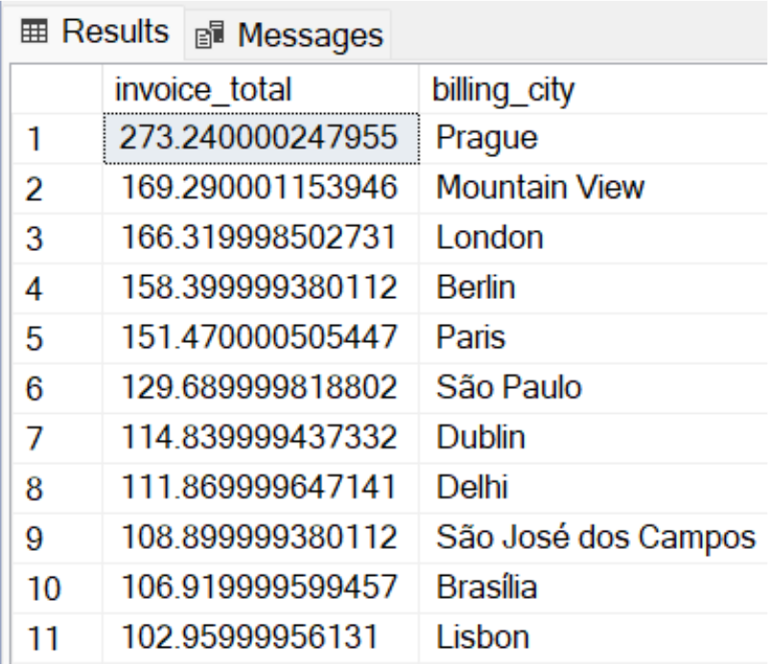
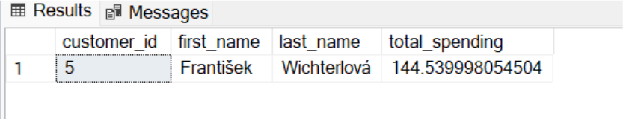
/* Question Set 1 - Easy */
1.Who is the senior most employee based on job title?
SELECT * FROM employee
ORDER BY levels desc
2.Which country have the most invoices ?
SELECT COUNT() as c,
billing_country FROM invoice
GROUP BY billing_country
ORDER BY c desc
3.What are top 3 of total invoices ?
SELECT Top 3 * FROM invoice
ORDER BY total desc
4.which city has the best customers? We would like to throw a promotional Music Festival in the city we made the most money. Write a query that returns one city that has the highest sum of invoice totals. Return both the city name and sum of all invoice total .
SELECT SUM(total) as invoice_total, billing_city FROM invoice
GROUP BY billing_city
ORDER BY invoice_total desc
5.Who is the best customer? The Customer who has spent the most money will be decelared the best customer Write a query that returns the person who has spent the most money.
SELECT Top 1 customer.customer_id, first_name, last_name, SUM(total) AS total_spending
FROM customer JOIN invoice ON customer.customer_id = invoice.customer_id
GROUP BY customer.customer_id, first_name, last_name
ORDER BY total_spending DESC

Slide 4
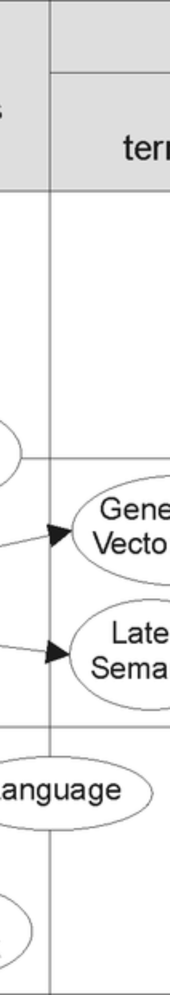
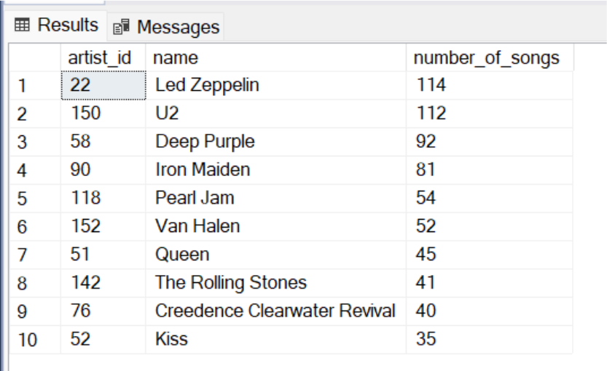
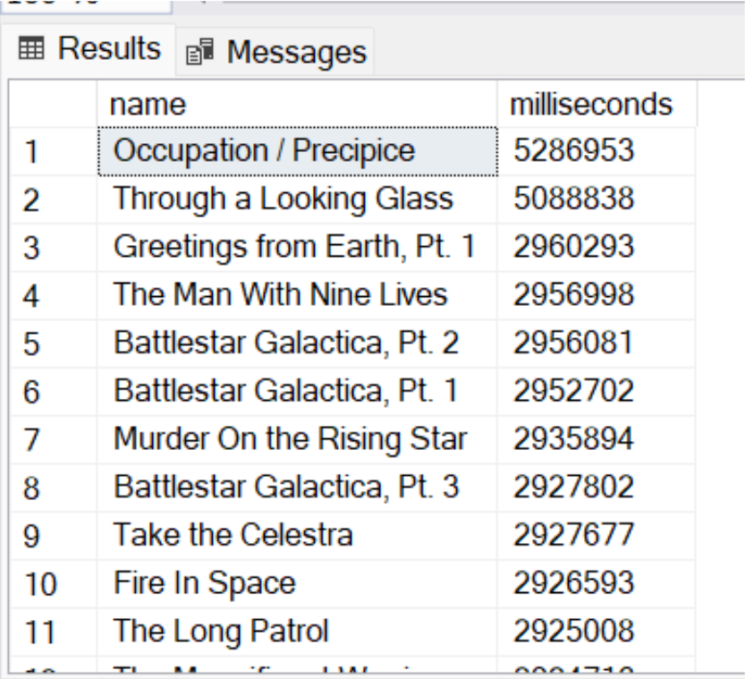
/* Moderate type query */
1.Write query to return the email, first name, last name, & Genre of all Rock Music listeners. Return your list ordered alphabetically by email starting with A
SELECT DISTINCT email,first_name,last_name FROM customer
JOIN invoice ON customer.customer_id = invoice.customer_id
JOIN invoice_line ON invoice.invoice_id = invoice_line.invoice_id
WHERE track_id IN
( SELECT track_id FROM track
JOIN genre on track.genre_id = genre.genre_id
WHERE genre.name LIKE 'Rock' ) ORDER BY email;
2.Let's invite the artists who have written the most rock music in our dataset. Write a query that returns the Artist name and total track count of the top 10 rock bands.
SELECT TOP 10 artist.artist_id, artist.name,COUNT(track.track_id)
AS number_of_songs FROM track
JOIN album ON album.album_id = track.album_id
JOIN artist ON artist.artist_id = album.artist_id
JOIN genre ON genre.genre_id = track.genre_id
WHERE genre.name LIKE 'Rock'
GROUP BY artist.artist_id, artist.name
ORDER BY number_of_songs DESC
3.Return all the track names that have a song length longer than the average song length. Return the Name and Milliseconds for each track. Order by the song length with the longest songs listed first.
SELECT name, milliseconds FROM track
WHERE milliseconds > ( SELECT AVG(milliseconds)
AS avg_track_length FROM track )
ORDER BY milliseconds DESC;

Slide 5
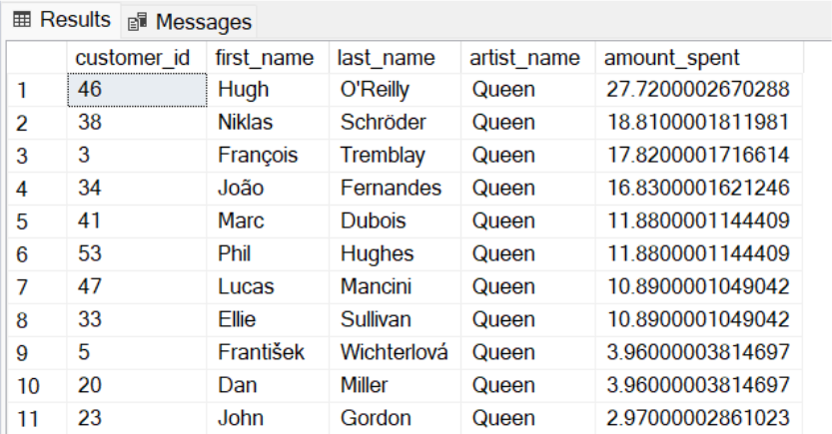
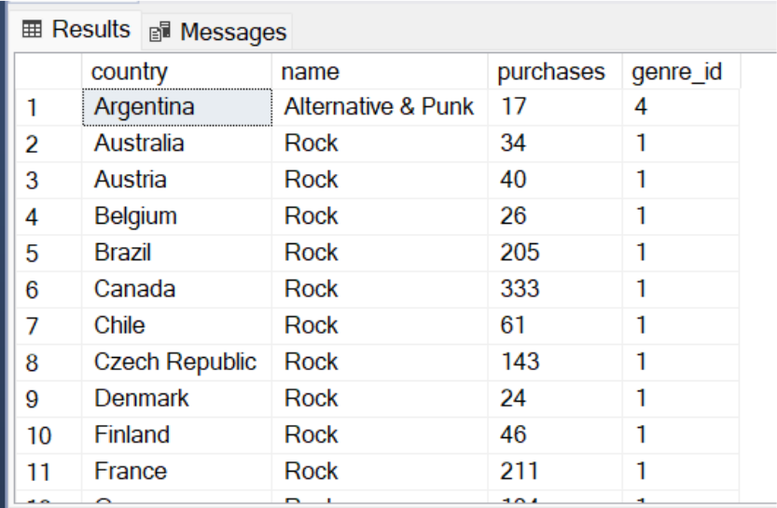
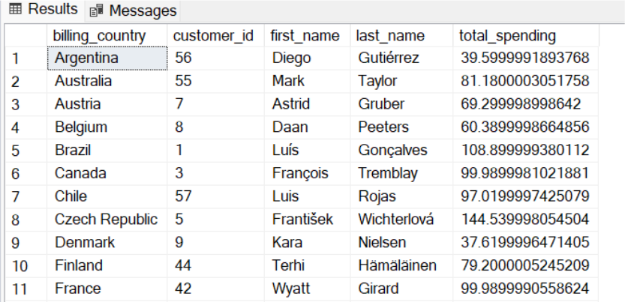
/* Advance Type Query */
1.Find how much amount spent by each customer on artists? Write a query to return customer name, artist name and total spent
Steps to Solve:
First, find which artist has earned the most according to the InvoiceLines. Now use this artist to find which customer spent the most on this artist.
For this query, you will need to use the Invoice, InvoiceLine, Track, Customer, Album, and Artist tables. Note, this one is tricky because the Total spent in the Invoice table might not be on a single product, so you need to use the InvoiceLine table to find out how many of each product was purchased, and then multiply this by the price for each artist.
WITH best_selling_artist AS ( SELECT TOP 1 artist.artist_id AS artist_id, artist.name AS artist_name, SUM(invoice_line.unit_priceinvoice_line.quantity) AS total_sales FROM invoice_line
JOIN track ON track.track_id = invoice_line.track_id
JOIN album ON album.album_id = track.album_id
JOIN artist ON artist.artist_id = album.artist_id
GROUP BY artist.artist_id, artist.name ORDER BY 3 DESC )
SELECT c.customer_id, c.first_name, c.last_name, bsa.artist_name, SUM(il.unit_priceil.quantity) AS amount_spent FROM invoice i
JOIN customer c ON c.customer_id = i.customer_id
JOIN invoice_line il ON il.invoice_id = i.invoice_id
JOIN track t ON t.track_id = il.track_id
JOIN album alb ON alb.album_id = t.album_id
JOIN best_selling_artist bsa ON bsa.artist_id = alb.artist_id
GROUP BY c.customer_id, c.first_name, c.last_name, bsa.artist_name
ORDER BY 5 DESC;
2.We want to find out the most popular music Genre for each country. We determine the most popular genre as the genre with the highest amount of purchases. Write a query that returns each country along with the top Genre. For countries where the maximum number of purchases is shared return all Genres.
Steps to Solve: There are two parts in question- first most popular music genre and second need data at country level.
/* Method : Using CTE */
WITH popular_genre AS ( SELECT COUNT(invoice_line.quantity) AS purchases, customer.country, genre.name, genre.genre_id, ROW_NUMBER() OVER(PARTITION BY customer.country
ORDER BY COUNT(invoice_line.quantity) DESC) AS RowNo FROM invoice_line
JOIN invoice ON invoice.invoice_id = invoice_line.invoice_id
JOIN customer ON customer.customer_id = invoice.customer_id
JOIN track ON track.track_id = invoice_line.track_id
JOIN genre ON genre.genre_id = track.genre_id
GROUP BY customer.country, genre.name, genre.genre_id ) SELECT country, name, purchases, genre_id FROM popular_genre WHERE RowNo <= 1
ORDER BY country ASC, purchases DESC;
3.Write a query that determines the customer that has spent the most on music for each country. Write a query that returns the country along with the top customer and how much they spent. For countries where the top amount spent is shared, provide all customers who spent this amount.
Steps to Solve: Similar to the above question. There are two parts in question- first find the most spent on music for each country and second filter the data for respective customers.
/* Method : using CTE */
WITH Customer_with_country AS ( SELECT customer.customer_id, first_name, last_name, billing_country,
SUM(total) AS total_spending, ROW_NUMBER() OVER (PARTITION BY billing_country
ORDER BY SUM(total) DESC) AS RowNo FROM invoice
JOIN customer ON customer.customer_id = invoice.customer_id
GROUP BY customer.customer_id, first_name, last_name, billing_country )
SELECT billing_country, customer_id, first_name, last_name, total_spending FROM Customer_with_country
WHERE RowNo <= 1 ORDER BY billing_country ASC, total_spending DESC;
SQL_Project_Music_Store_Analysis
SQL project to analyze online music store data. By leveraging the power of SQL, we'll gain valuable insights into customer behavior, music trends, and overall store performance. You can examine the dataset with SQL and help the store understand its business growth by answering simple questions.
Data:
The project will utilize a dataset comprising tables related to different aspects of the online music store, typically including:
Customers: Customer information like ID, name, location, etc. Tracks: Track details like ID, title, artist, genre, etc.
Invoices: Invoice information like ID, customer ID, purchase date, etc.
Invoice lines: Individual items purchased in an invoice (track ID, quantity, price, etc.).
Genres: Genre information like ID, name, etc.
Database and Tools
Postgre SQL
PgAdmin4
Complete Analysis
Dive deeper into complex queries for multifaceted analysis of music store data.
Optimization Techniques
Explore indexing strategies, query optimization, and performance tuning for efficient data retrieval and processing.
Visualizations
Learn to integrate SQL query results into graphical forms for enhanced data representation.

